Slide 1
CS474: Operating Systems I
Synchronization: The Baboon problem
Ne'kko Montoya, Navarre Brown, and Jason Miller
New Mexico State University
Computer Science

Slide 2
Introduction
The baboon Synchronization problem

Slide 3



Synchronization: Baboon Problem
Baboons are located on two edges of a canyon.
The baboons on one side of the canyon want to travel across to the other side and vice versa.
There is a long rope that spans the canyon used for baboon travel.
If baboons traveling in opposite directions on the rope meet, they both fall to their deaths.
Use synchronization to ensure the baboons can make it to the other side safely.

Slide 4
Problem Identification - Synchronization Scheme
This is a type of readers-writers synchronization problem, a problem in which one or more processes or threads write data while others only read data. [4]
Requirements:
Once a baboon has began to cross, it is guaranteed to cross without interference from the other side.
Limit of three baboons on the rope, order preserved.
Solution must be starvation free.
The rope is a common resource, easily handled using semaphores.
Notes:
Starvation - A continuing stream of baboons crossing in one direction should not bar baboons going the other way indefinitely

Slide 5
Our Implementation
The baboon Synchronization Solution

Slide 6
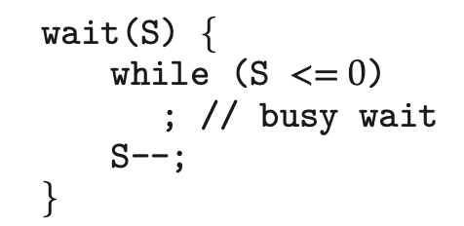
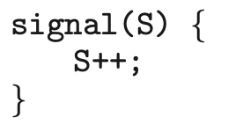
What are semaphores?
A semaphore is an integer variable that apart from initialization it can only be accessed through two standard atomic operations: wait() and signal().
All Operations which modify the integer value of the semaphore must be done atomically.
Two processes cannot modify the semaphore simultaneously.
Notes:
Starvation - A continuing stream of baboons crossing in one direction should not bar baboons going the other way indefinitely

Slide 7
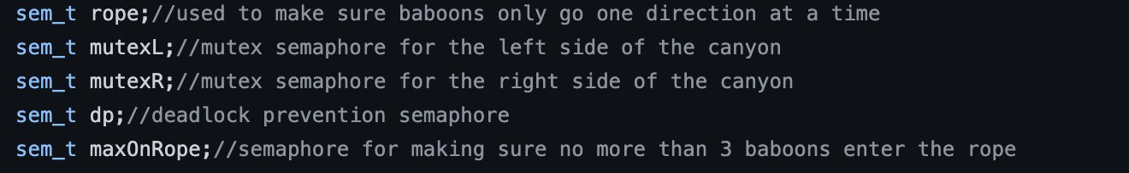
Semaphores
Our solution utilized a total of 5 semaphores:
One representing the rope.
Two for each side of the canyon.
One for Deadlock prevention.
One for enforcing the three-baboon limit.

Slide 8
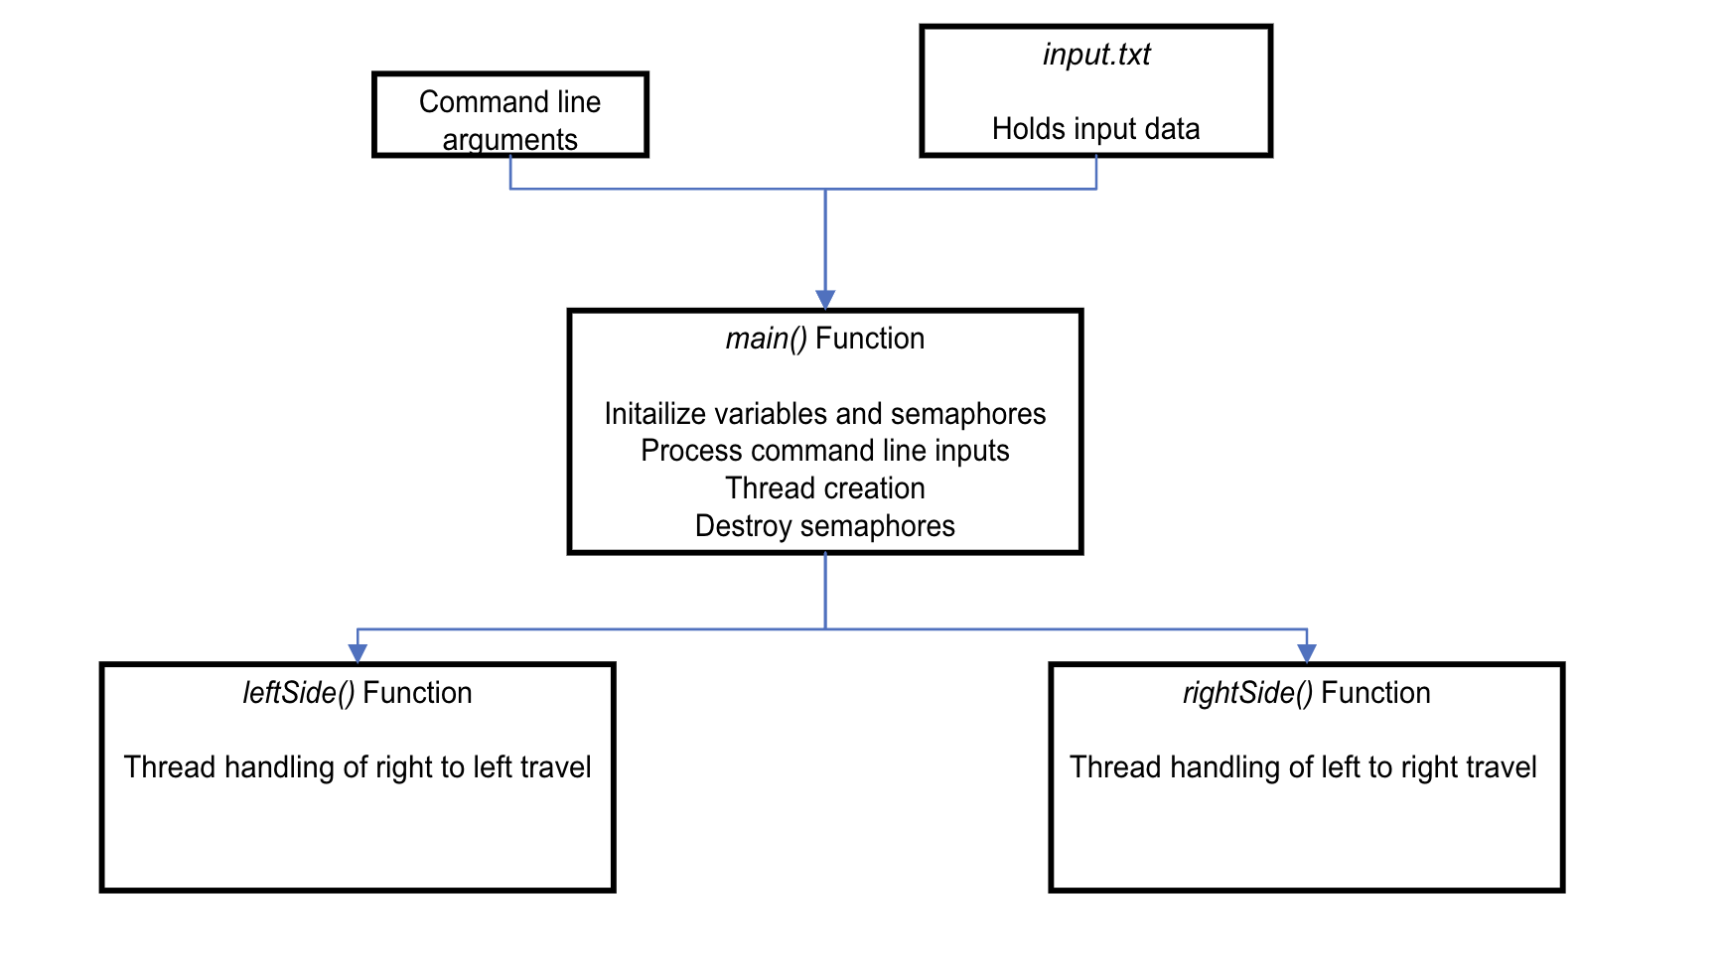
Code Overview

Slide 9
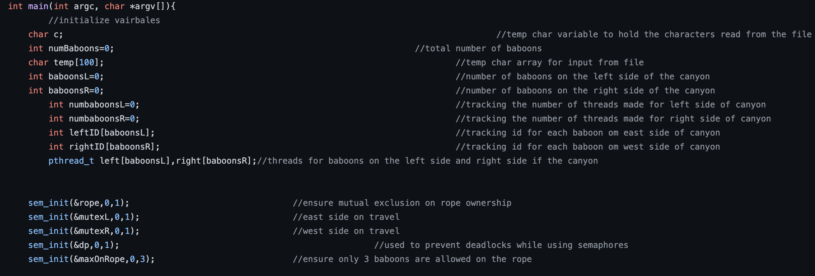
The main() Function
Semaphore Initialization

Slide 10
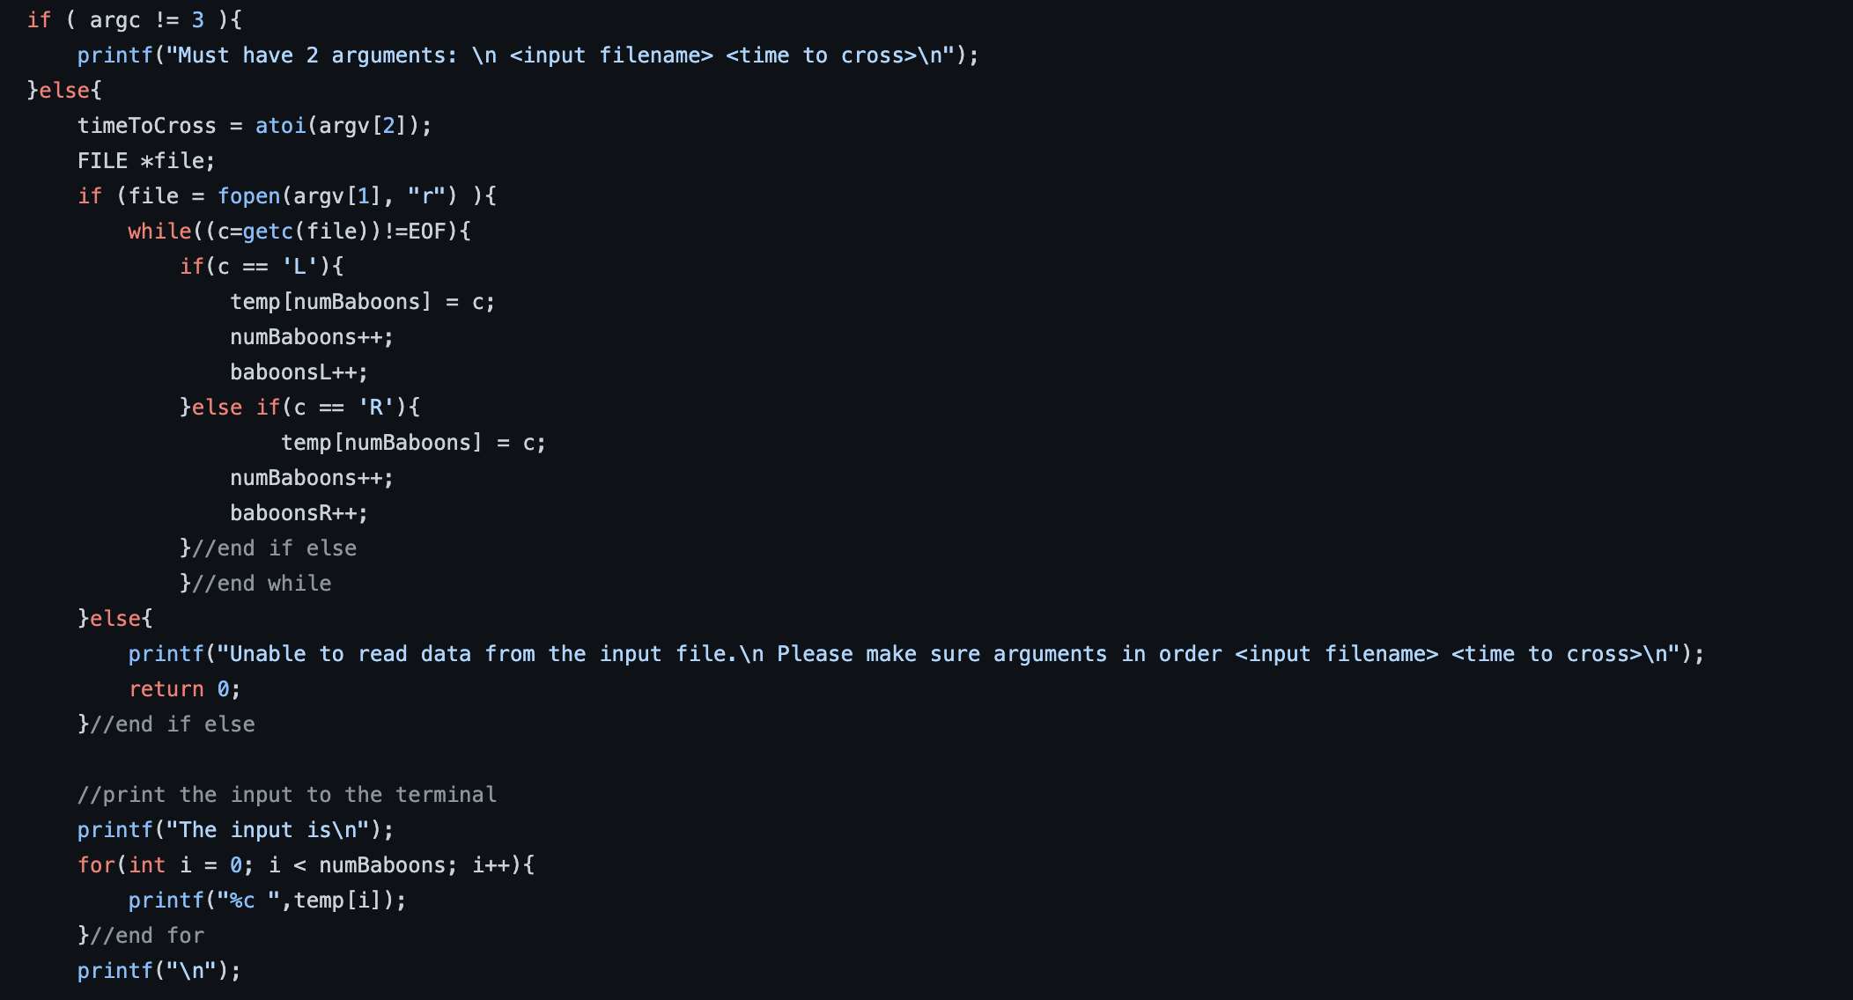
The main() Function

Slide 11
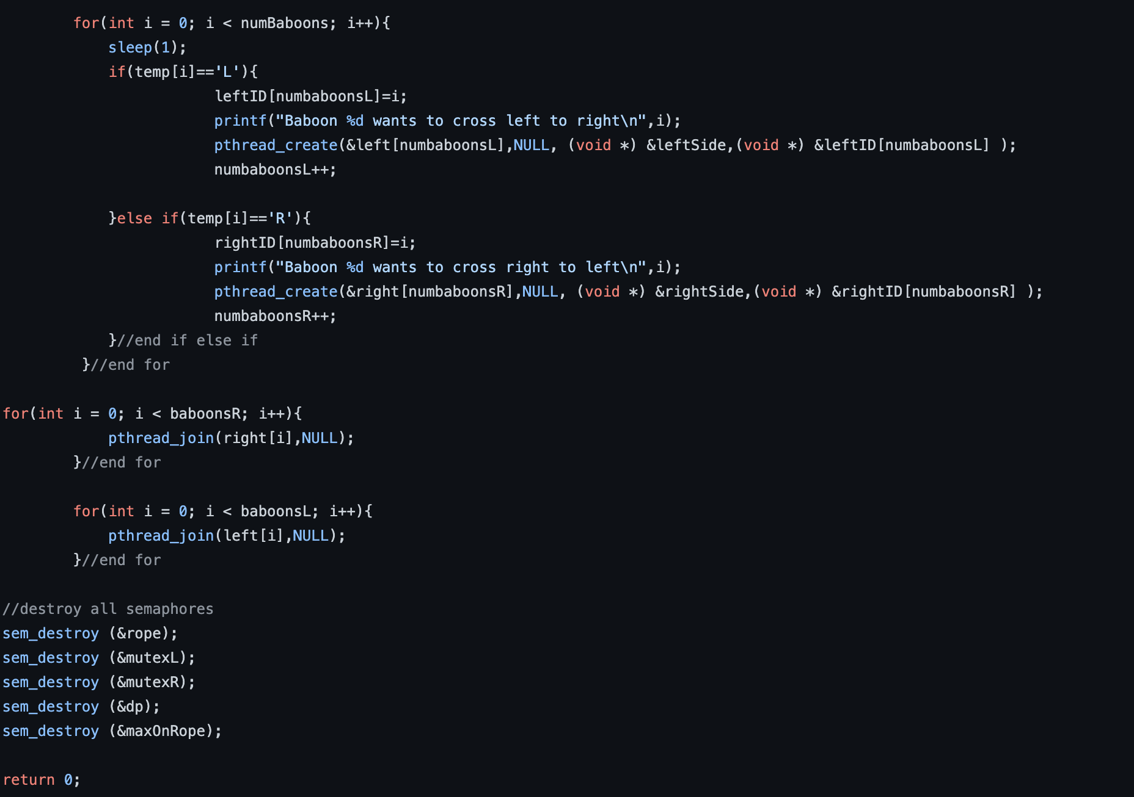
The main() Function

Slide 12
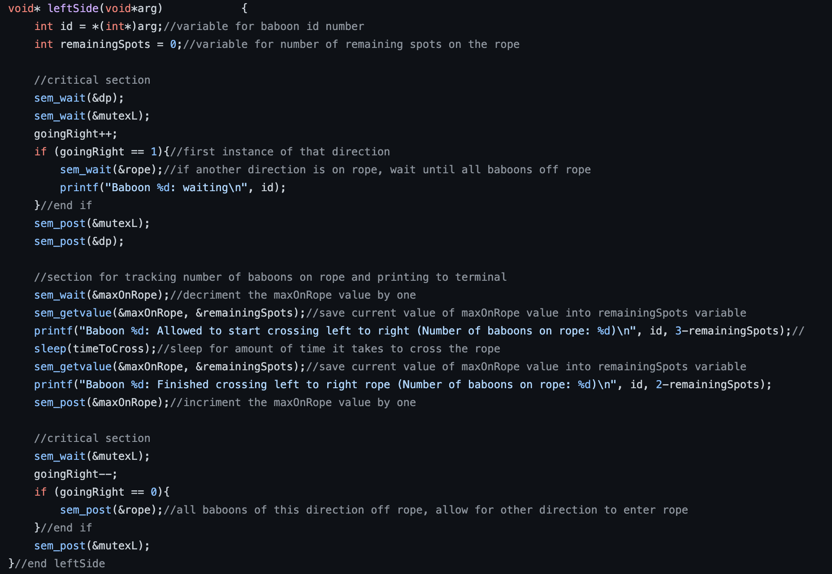
The leftSide() Function
Critical sections which capture synchronization requirements
Enforces three-baboon limit
Notes:
rightSide is very similar so do not include.

Slide 13
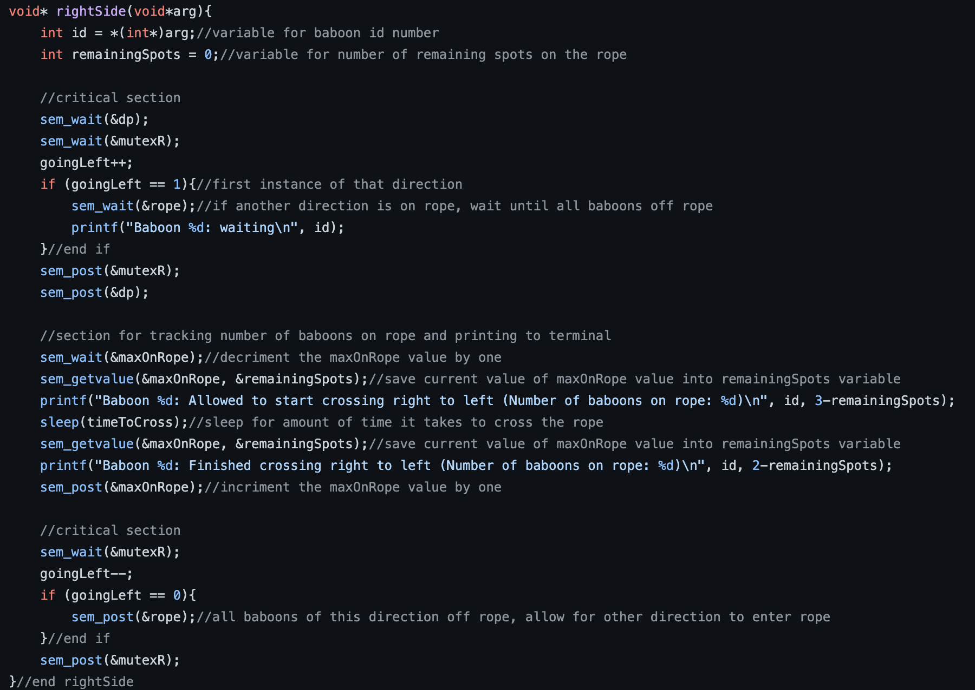
The rightSide() Function

Slide 14
Results
sample output

Slide 15
Compilation
Compilation is very simple: gcc prob1.c -o -lpthread -lrt

Slide 16
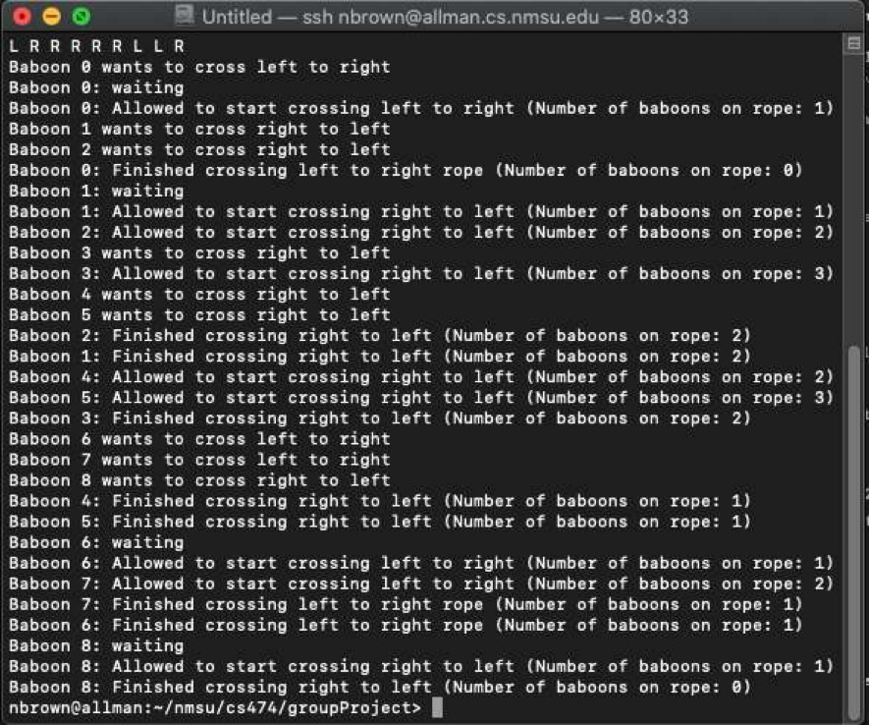
Sample Output

Slide 17
Questions?

Slide 18
References
https://mapeffects.co/tutorials/canyons
https://www.freepik.com/author/abbydesign
https://www.dreamstime.com/illustration/straight-rope.html
Silberschatz, Abraham, et al. “Glossary.” Operating System Concepts, J. Wiley & Sons, Hoboken, NJ, 2019, pp. G-29-G-30.

Slide 19
Glossary

